Slide 1
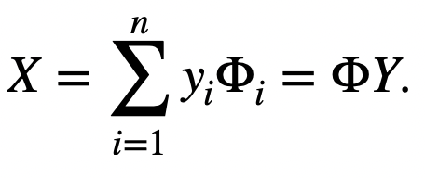
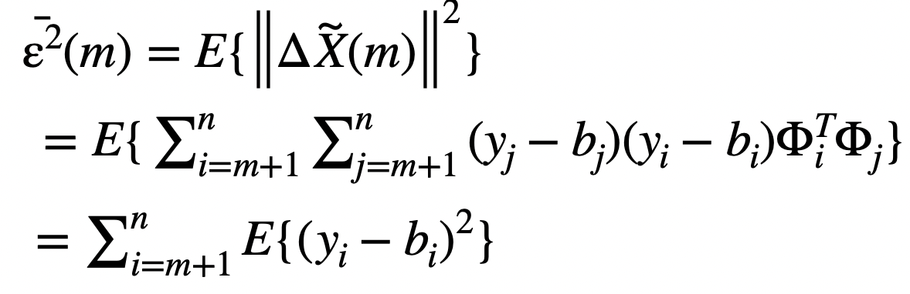
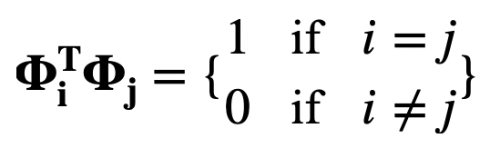
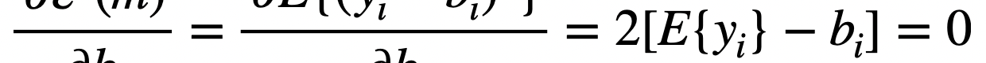
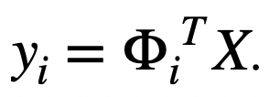
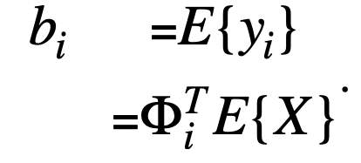
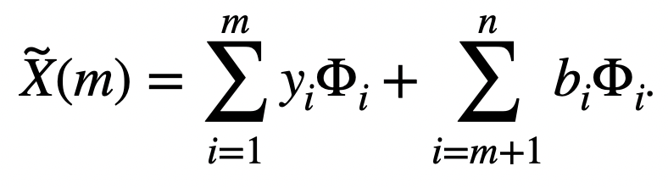
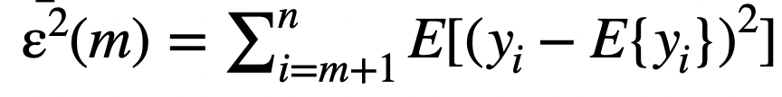
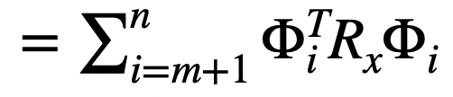
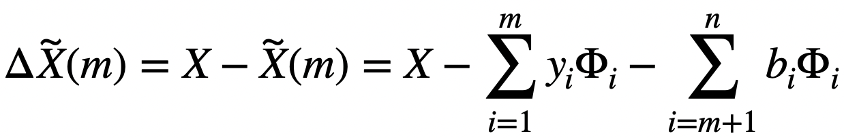
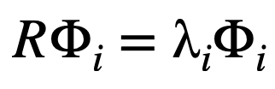
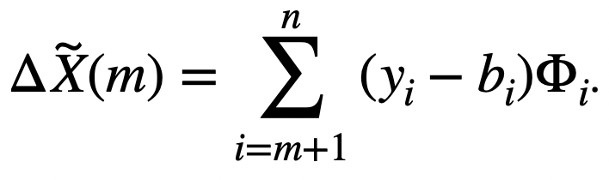
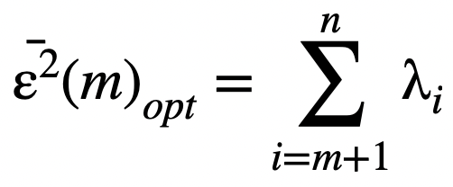
Activity 3: PCA for Compression
Physics 301
Submitted by: Mark Jeremy G. Narag
Student Number: 2014-64423
Program: PhD Physics

Slide 2
Objectives
Derive eigenvectors and their eigenvalues from image (this activity) and spectral data (next activity).
Convert a digital camera into a spectral imager using principal components analysis (next activity).
Reconstruct images of faces using PCA.

Slide 3
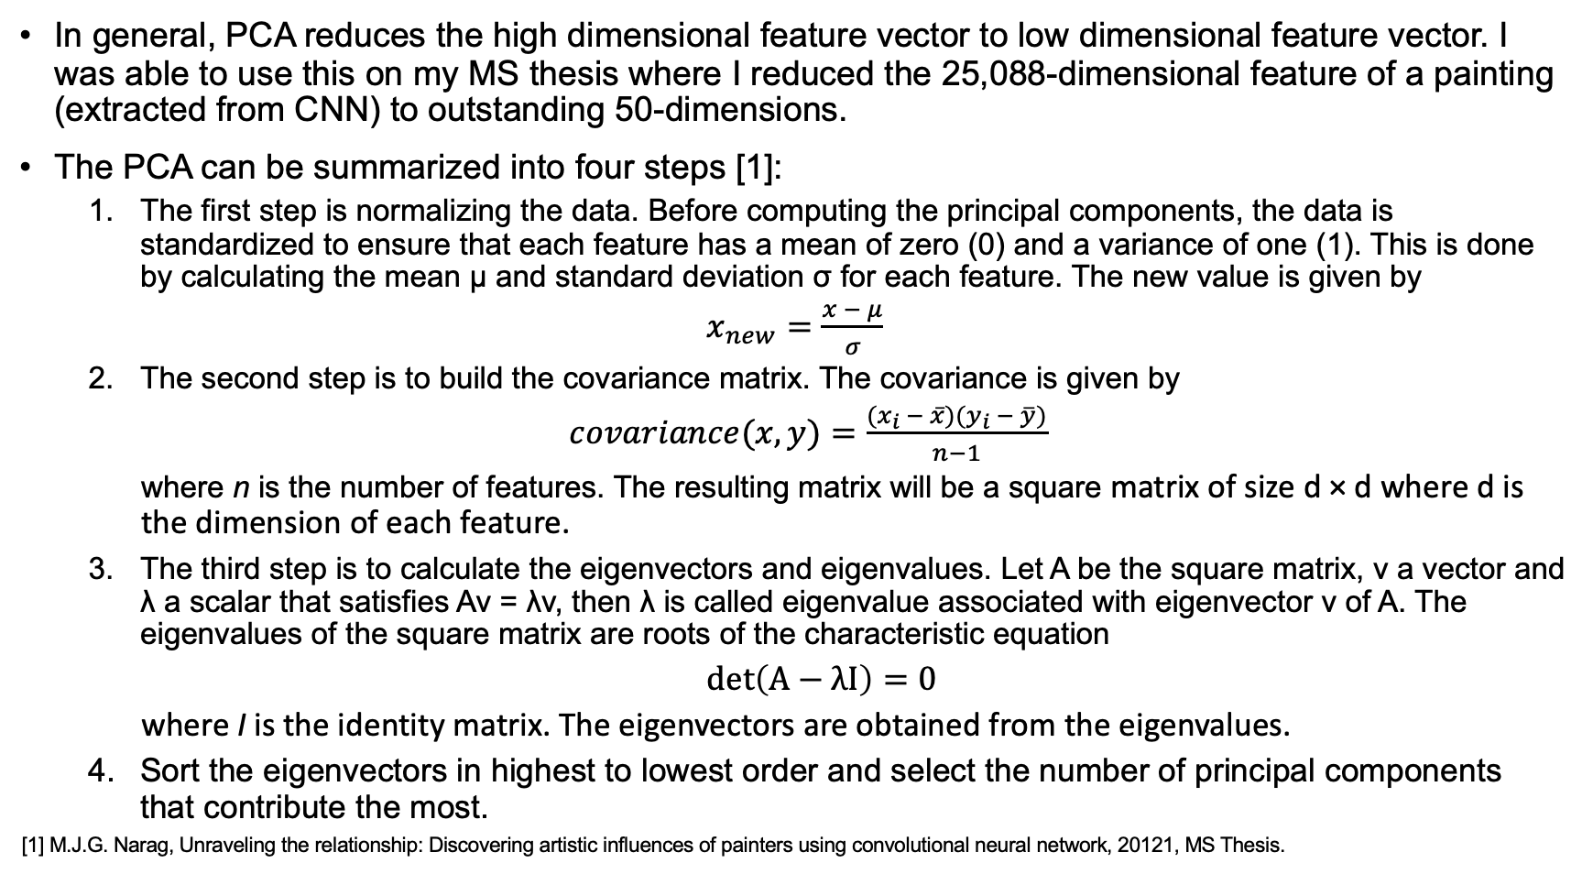
Principal Component Analysis (PCA)
In general, PCA reduces the high dimensional feature vector to low dimensional feature vector. I was able to use this on my MS thesis where I reduced the 25,088-dimensional feature of a painting (extracted from CNN) to outstanding 50-dimensions.
The PCA can be summarized into four steps [1]:
The first step is normalizing the data. Before computing the principal components, the data is standardized to ensure that each feature has a mean of zero (0) and a variance of one (1). This is done by calculating the mean μ and standard deviation σ for each feature. The new value is given by
$x_{new}=\frac{x − μ}{σ}$
The second step is to build the covariance matrix. The covariance is given by
$covariance(x,y)=\frac{(x_{i} − \overline{x})(y_{i} − \overline{y})}{n−1}$
where n is the number of features. The resulting matrix will be a square matrix of size d × d where d is the dimension of each feature.
The third step is to calculate the eigenvectors and eigenvalues. Let A be the square matrix, v a vector and λ a scalar that satisfies Av = λv, then λ is called eigenvalue associated with eigenvector v of A. The eigenvalues of the square matrix are roots of the characteristic equation
$\det\left(A−λI\right)=0$
where I is the identity matrix. The eigenvectors are obtained from the eigenvalues.
Sort the eigenvectors in highest to lowest order and select the number of principal components that contribute the most.
[1] M.J.G. Narag, Unraveling the relationship: Discovering artistic influences of painters using convolutional neural network, 20121, MS Thesis.

Slide 4
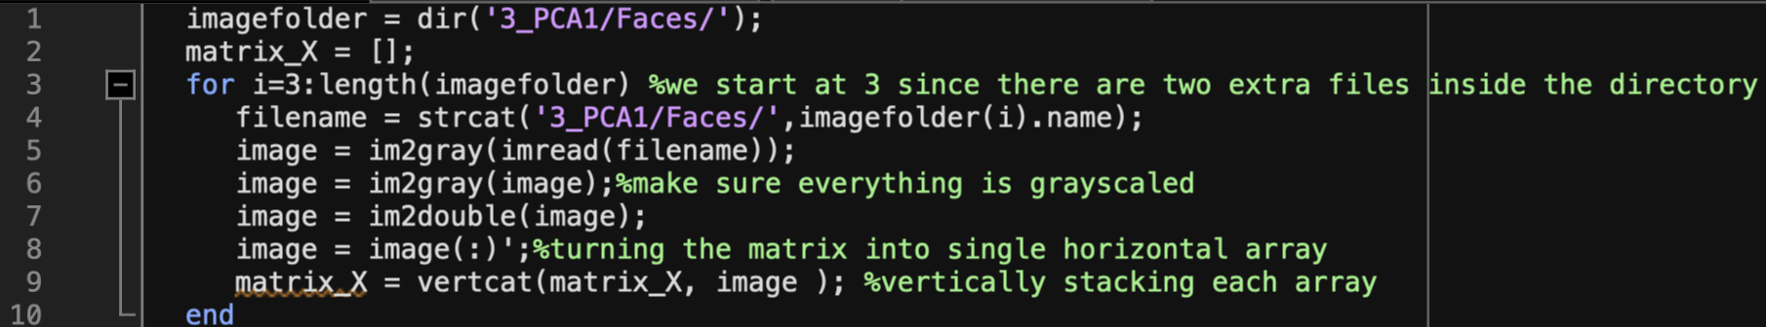
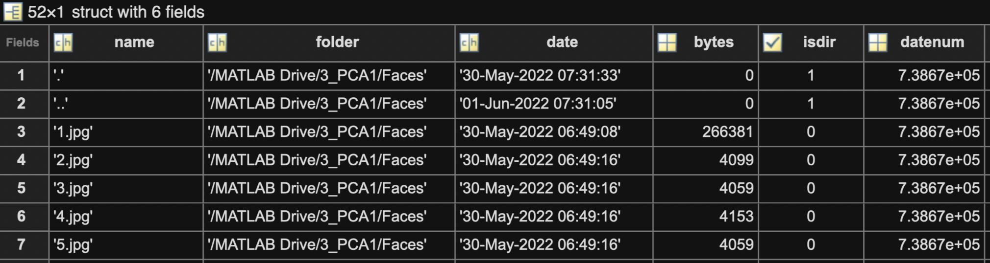
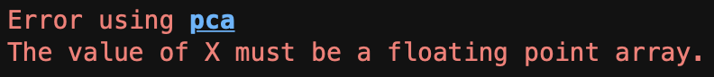

Matlab code to read the images and store it in a 2D matrix:
In Line 3, we start at i=3 because for some unknown reason, there are two extra files stored in the directory (boxed in red):
We also need to impose line 7 or less we will get this error when we apply PCA in matrix_X:
Our data only have 50 faces (from 10 people) with size 50 by 50. Therefore, matrix_X has a dimension 50 by 2500:
We impose line 6 because some pictures are not grayscaled.

Slide 5
Matlab code for applying PCA and getting the cumulative sum of the normalized eigenvalues to find out how many principal components out of the 2500 possible ones can represent the face up to 99% (or with 1% error only) :
When I run line 11, I get this message from Matlab:
Note:
COEFF = pca(X) returns the principal component coefficients for the N by P data matrix X. Rows of X correspond to observations and columns to variables. Each column of COEFF contains coefficients for one principal component. The columns are in descending order in terms of component variance (LATENT). pca, by default, centers the data and uses the singular value decomposition algorithm. For the non-default options, use the name/value pair arguments.
[COEFF, SCORE] = pca(X) returns the principal component score, which is the representation of X in the principal component space. Rows of SCORE correspond to observations, columns to components. The centered data can be reconstructed by SCORE*COEFF’.
[COEFF, SCORE, LATENT] = pca(X) returns the principal component variances,i.e., the eigenvalues of the covariance matrix of X, in LATENT.
[COEFF, SCORE, LATENT, TSQUARED] = pca(X) returns Hotelling's T-squared statistic for each observation in X. pca uses all principal components to compute the TSQUARED (computes in the full space) even when fewer components are requested (see the 'NumComponents' option below). For TSQUARED in the reduced space, use MAHAL(SCORE,SCORE).
[COEFF, SCORE, LATENT, TSQUARED, EXPLAINED] = pca(X) returns a vector containing the percentage of the total variance/total contribution explained by each principal component.
[COEFF, SCORE, LATENT, TSQUARED, EXPLAINED, MU] = pca(X) returns the estimated mean, MU, when 'Centered' is set to true; and all zeros when set to false.

Slide 6
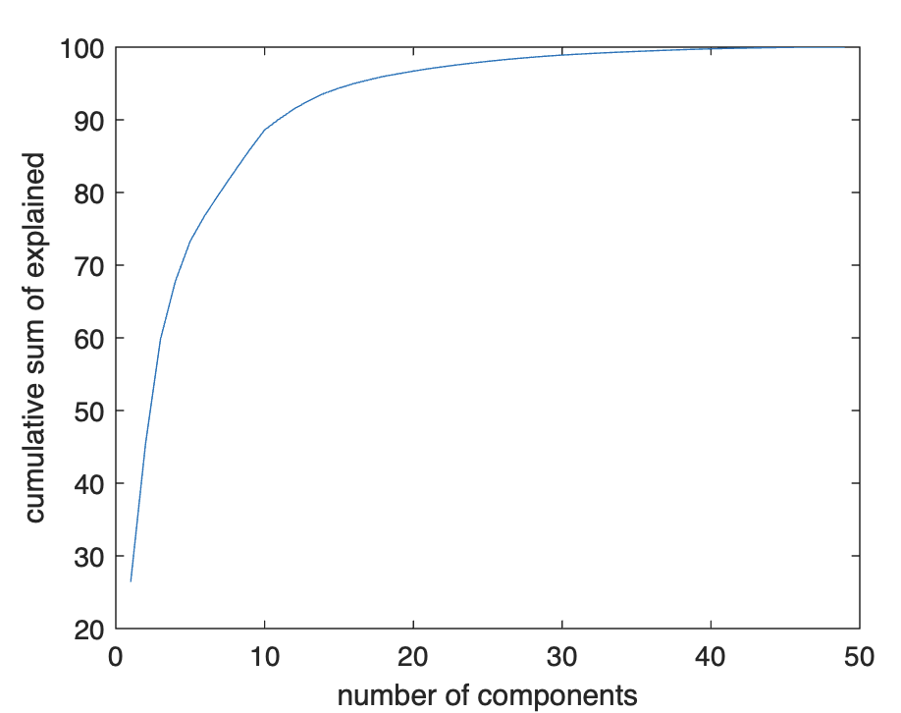
Matlab code for applying PCA and getting the cumulative sum of the normalized eigenvalues to find out how many principal components out of the 2500 possible ones can represent the face up to 99% (or with 1% error only) :
Result of Line 12:
Visualizing the cumsum(explained)
index | cumsum(explained)
1 | 26.4038
2 | 45.4471
3 | 59.7928
4 | 67.7702
5 | 73.3076
6 | 76.9046
7 | 79.9872
8 | 82.9789
9 | 85.8813
10 | 88.6016
11 | 90.1476
12 | 91.522
13 | 92.6637
14 | 93.6315
15 | 94.3562
16 | 94.9886
17 | 95.5044
18 | 95.9783
19 | 96.343
20 | 96.7028
21 | 97.0255
22 | 97.3121
23 | 97.5761
24 | 97.8181
25 | 98.0488
26 | 98.2539
27 | 98.4404
28 | 98.6128
29 | 98.7709
30 | 98.9064
31 | 99.0219
32 | 99.1336
33 | 99.2335
34 | 99.3236
35 | 99.4096
36 | 99.4919
37 | 99.5701
38 | 99.6438
39 | 99.7122
40 | 99.7666
41 | 99.8184
42 | 99.8585
43 | 99.895
44 | 99.9294
45 | 99.96
46 | 99.9866
47 | 99.9942
48 | 100
49 | 100
We only need 31 principal components to represent the face up to 99%

Slide 7
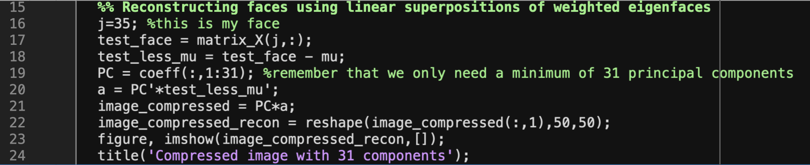
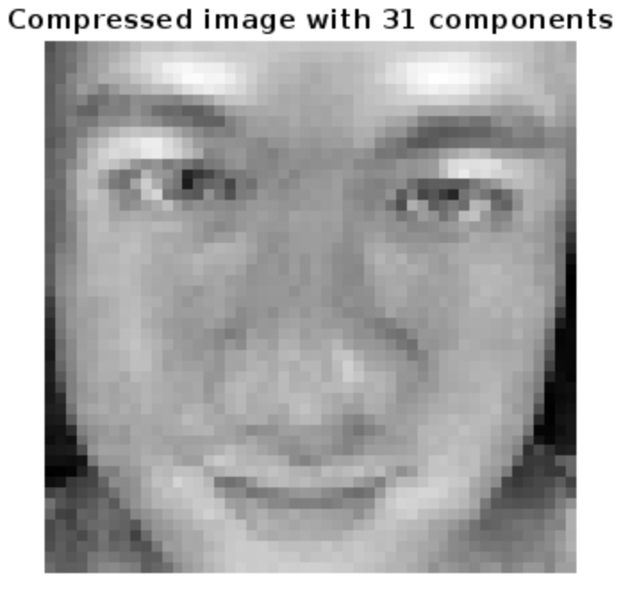
We are now ready to reconstruct the faces:
In line 22, we need to reconstruct image_compressed into a 2D array
Finally, here is the reconstructed compressed image:
Line 16 and 17 extracts one test image from matrix_X.
In line 18, we need to subtract mu to make it mean centered:
In line 19, we extract the 31 principal components from the coeff and name it PC:
In line 20, we then get the matrix multiplication of PC and test_less_mu to get the coefficients (labeled a):
In Line 21, we again apply matrix multiplication to PC and a to get the final compressed image in 1D:

Slide 8
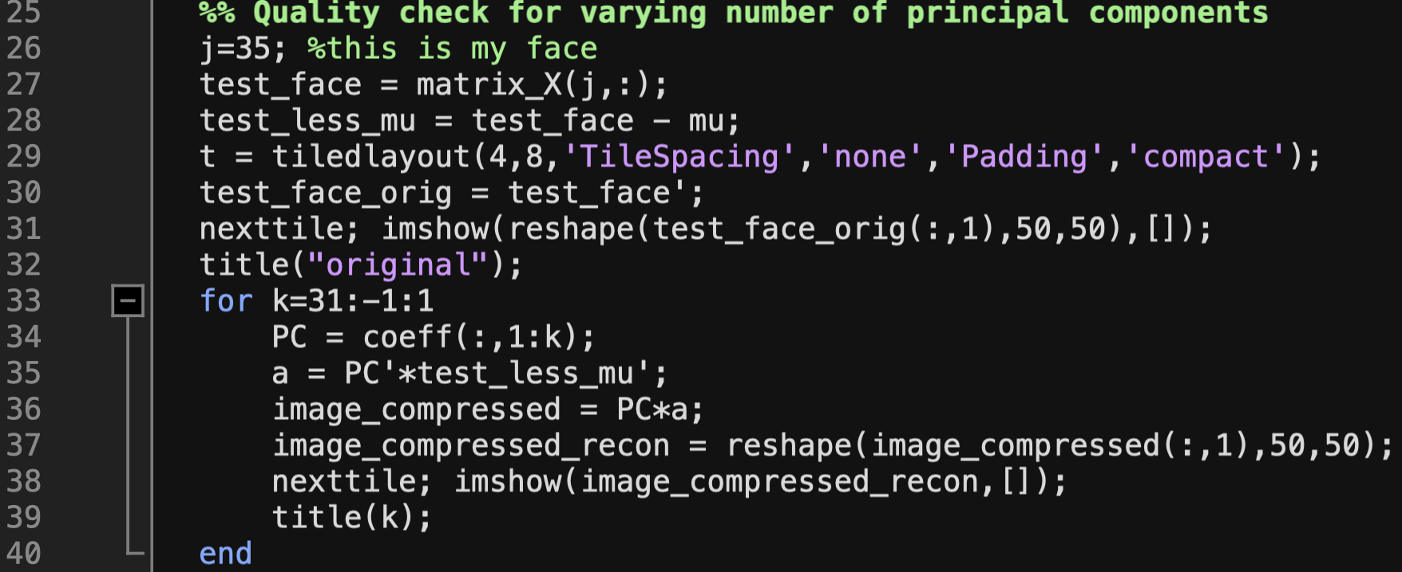
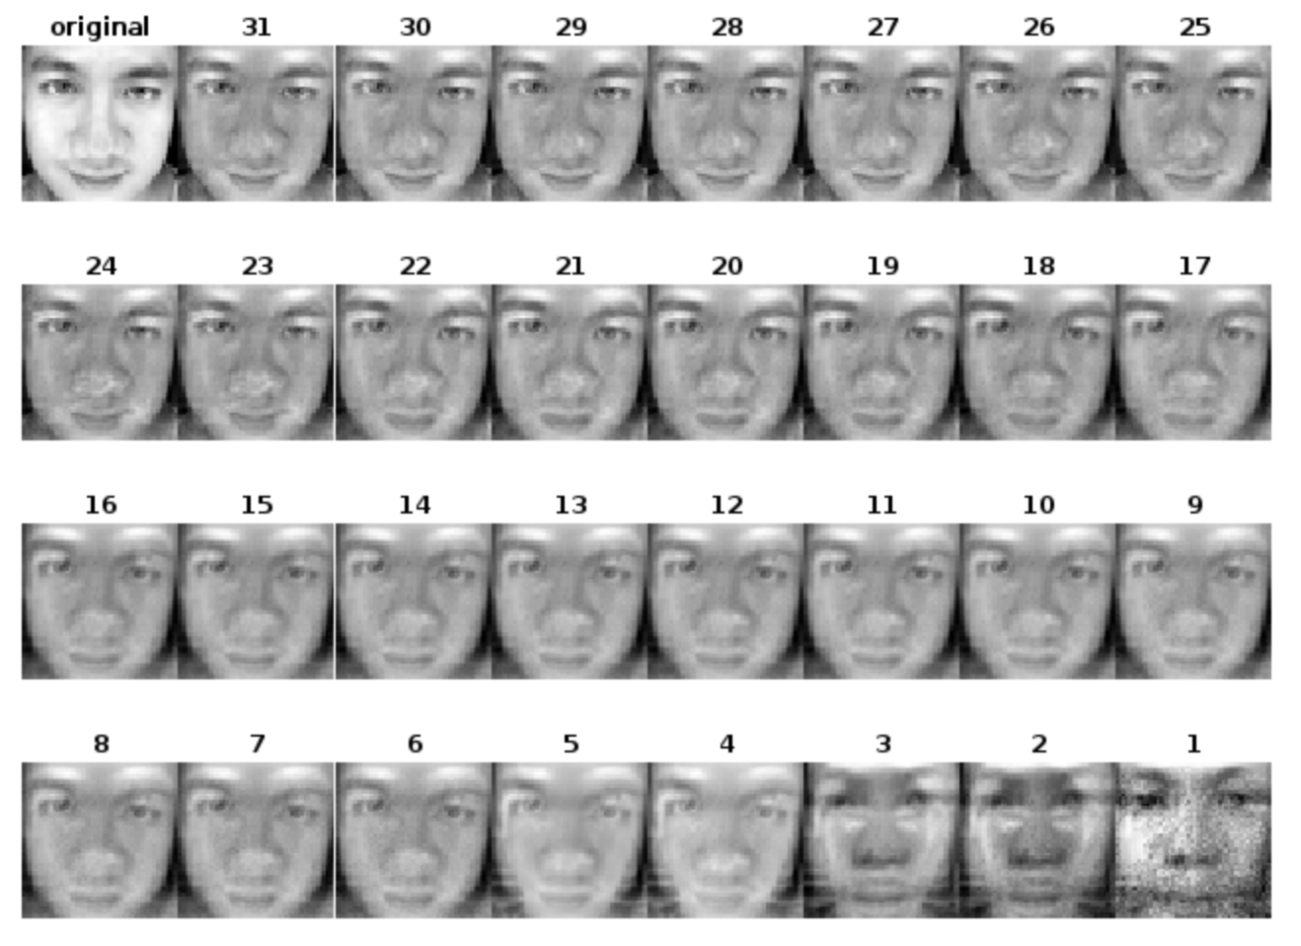
Matlab code to automatically generate the subfigures:
Rendered faces for varying number of principal components
We can see here that the face is unrecognizable for small number of principal components (1-5). We can however identify our face already using only 6 principal components (around 76% from the table in slide 5). Of course, better rendering can be seen as we add more and more principal components, but the change is gradual as expected from this plot:

Slide 9
More examples of rendered faces for varying number of principal components
Face 2
Face 3
Here, we can see the same pattern as before. I can already identify my face using only 6 principal components (around 76% from the table in slide 5). Might be bias because I know my face. Better rendering can of course be seen as we add more and more principal components.
Side comment: using 1 PC only, I can see Christian’s face. 2 and 3 PCs are a bit scary to look at.
The hardest part of this activity is how to look good on a 50 by 50 gray scaled version of myself without hair and ears! But glad I managed to pull it off, giving you ~FIERCE~ Asia’s Next Top Model mugshot realness! (char)
💅🏻
Face 4
Face 5

Slide 10
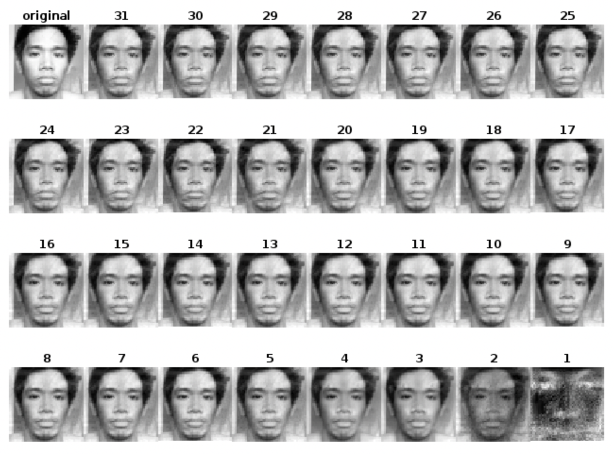
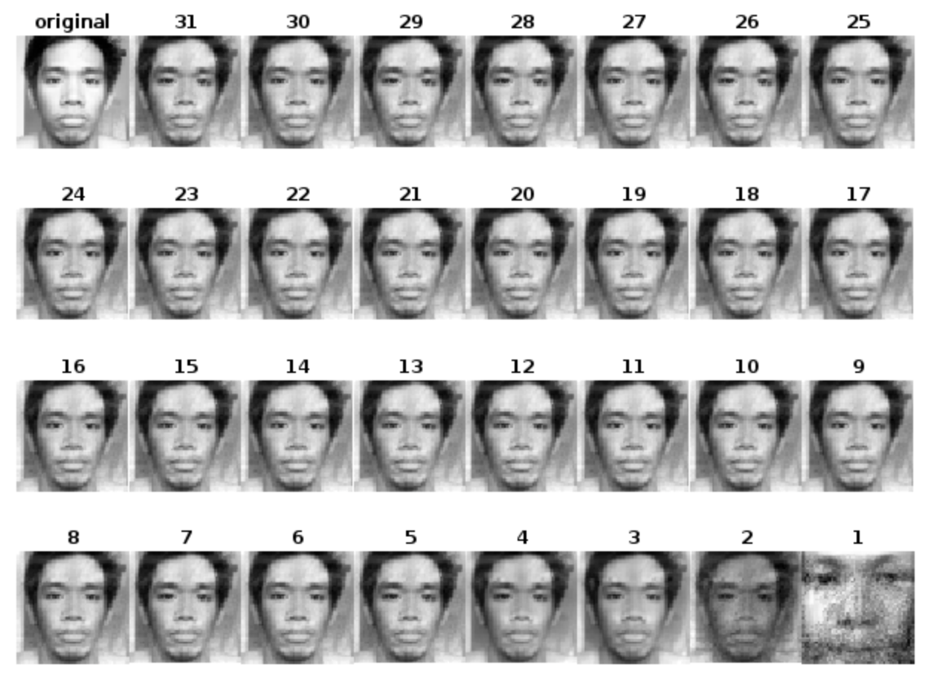
More examples of rendered faces for varying number of principal components
Some people, ehem Lloyd, did not follow the instruction of no hair and ears. Nonetheless, we can see the same pattern as before. Actually, at 3 PCs, we can already identify Lloyd’s face. For the plot on the right, PC=1, Christian’s face is really strong, you can really see it even on Lloyd’s reconstructed face.

Slide 11
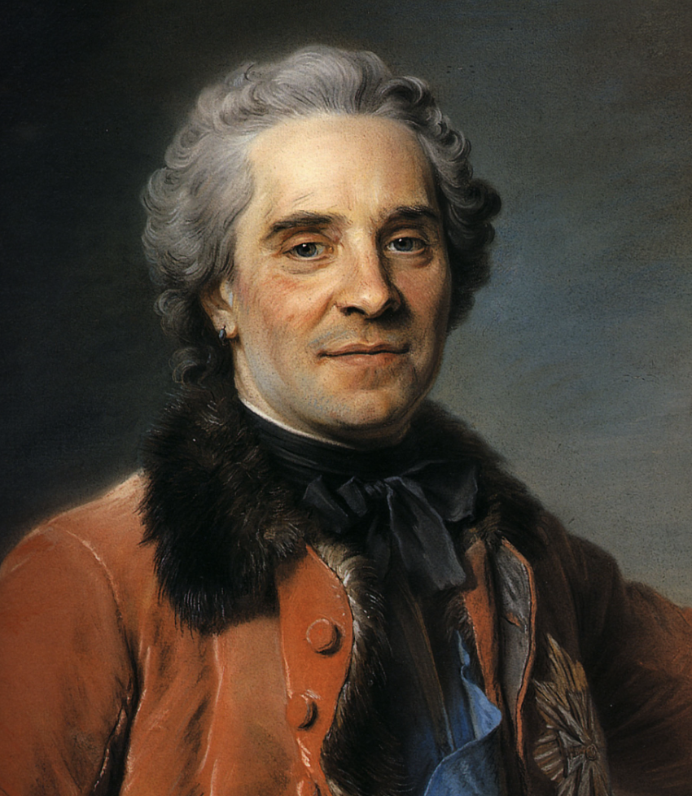
Instead of closeup faces, what if we try it on portrait paintings?

Slide 12
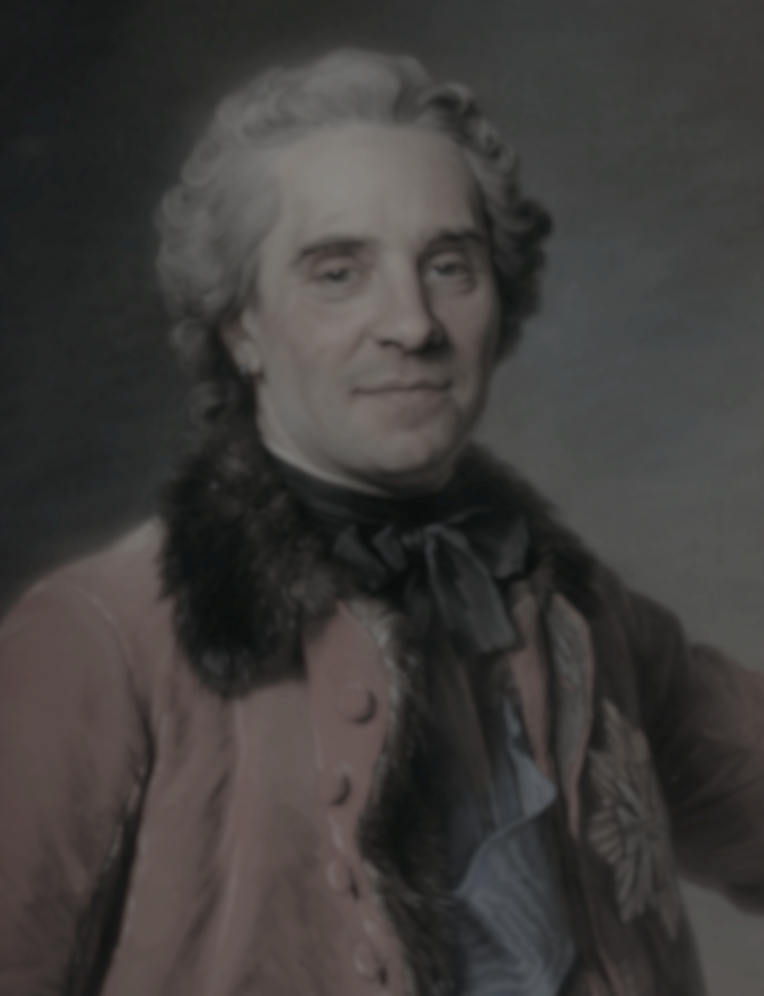
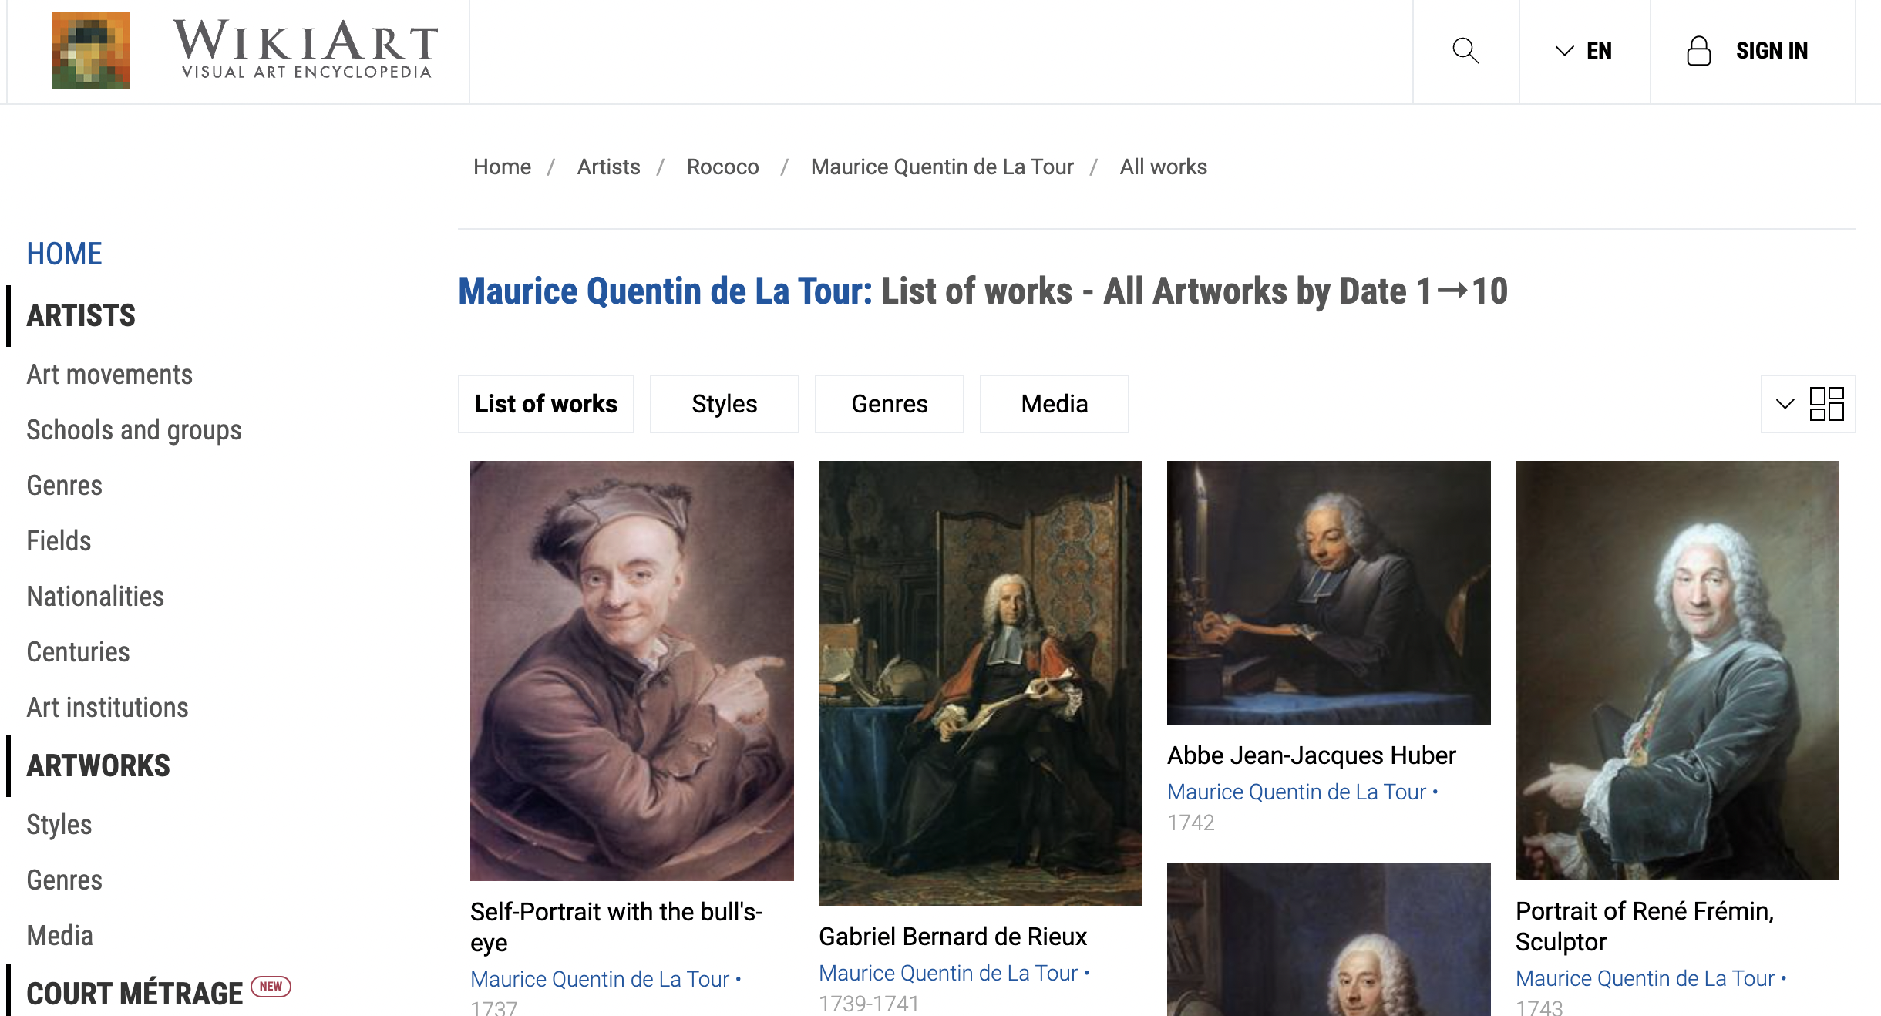
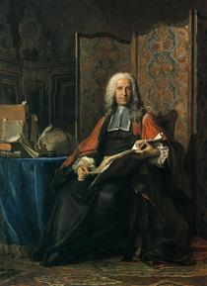
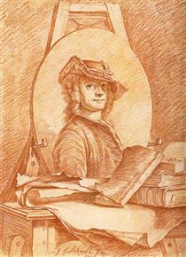
I was able to download 93 portrait paintings of Maurice Quentin de la Tour from WikiArt.org. They are of course in different sizes, so I just added a line in Matlab to reshape them:
I cleaned the data first by removing those that are full body portraits or sketches. We are left with 84 images.
Example of paintings removed

Slide 13
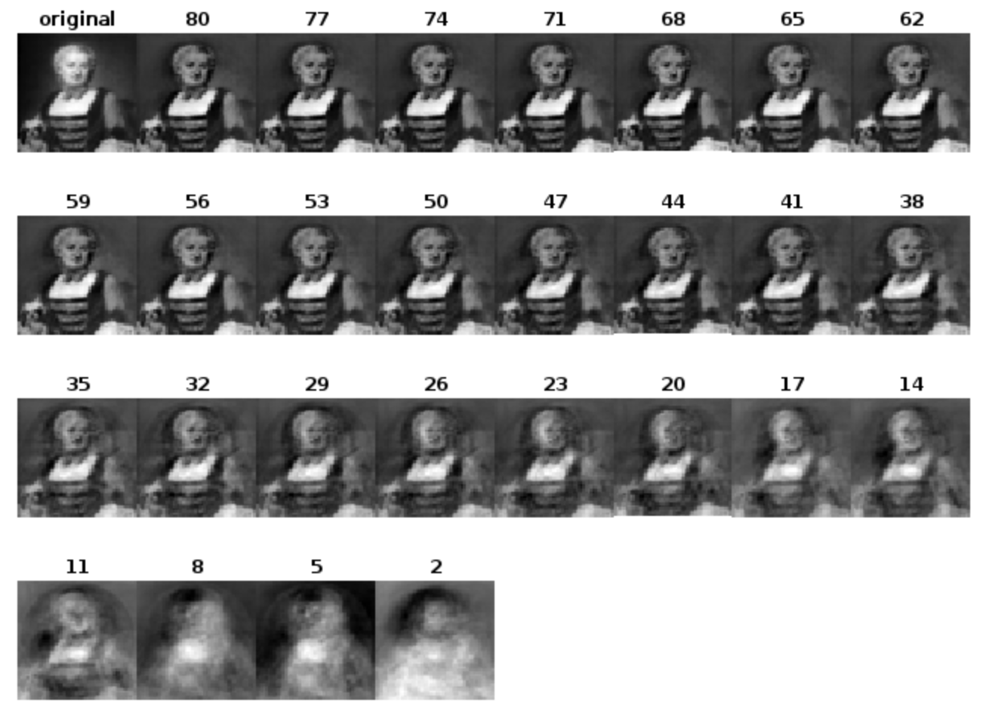
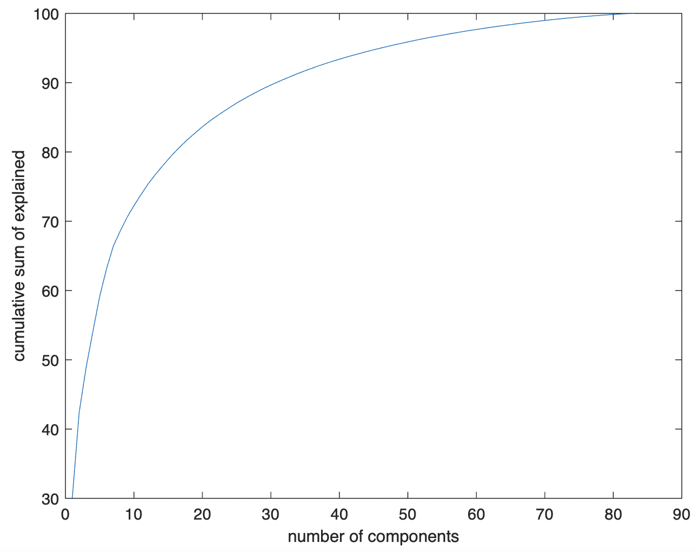
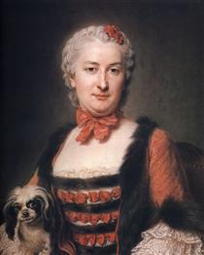
Sample of rendered portrait painting for various principal components (PC=80 min for 95% contribution)
PC = 47, 95%
PC = 71, 99%
At around PC=59, we can already identify the flower painting. PC=59 has 97.5279% contribution.

Slide 14
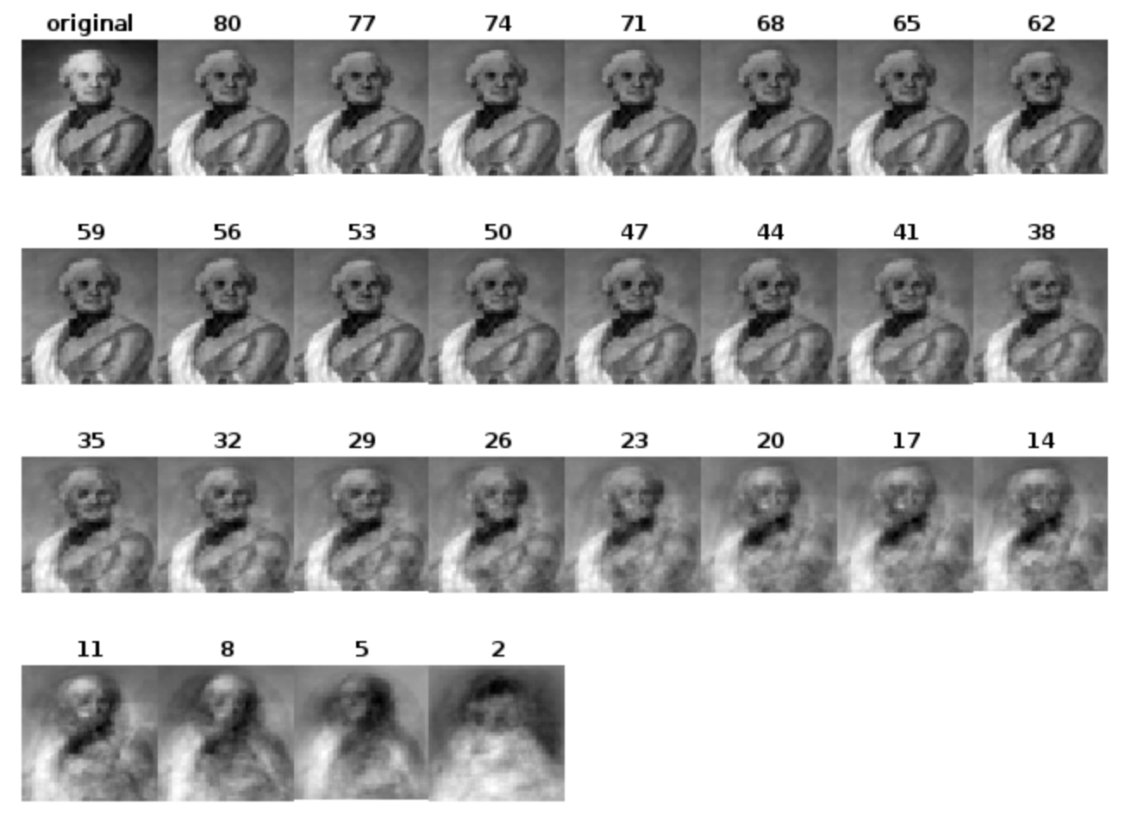
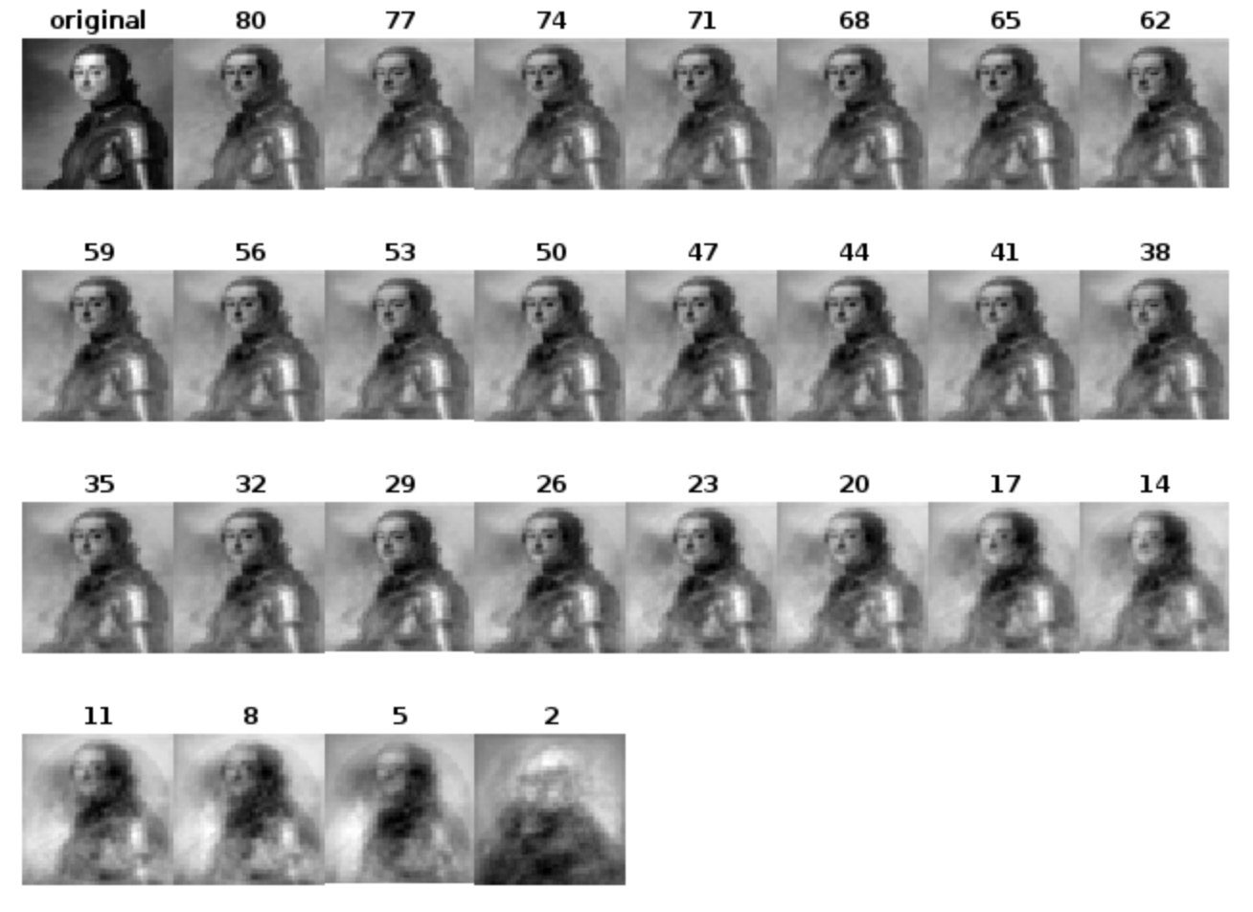
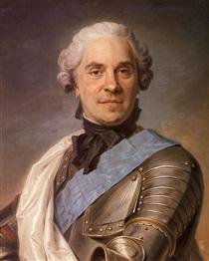
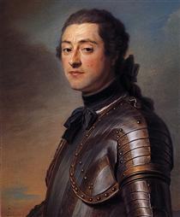
Sample of rendered portrait painting for various principal components (PC=80 min for 95% contribution)
At around PC=35 (91.7267% contribution) on the image on the left and PC=26 (87.6336% contribution) on the image on the right, we can already identify the portrait painting.
Of course, this observations are qualitative. But overall, we can conclude that even below 95% or 99%, we can identify the images.

Slide 15
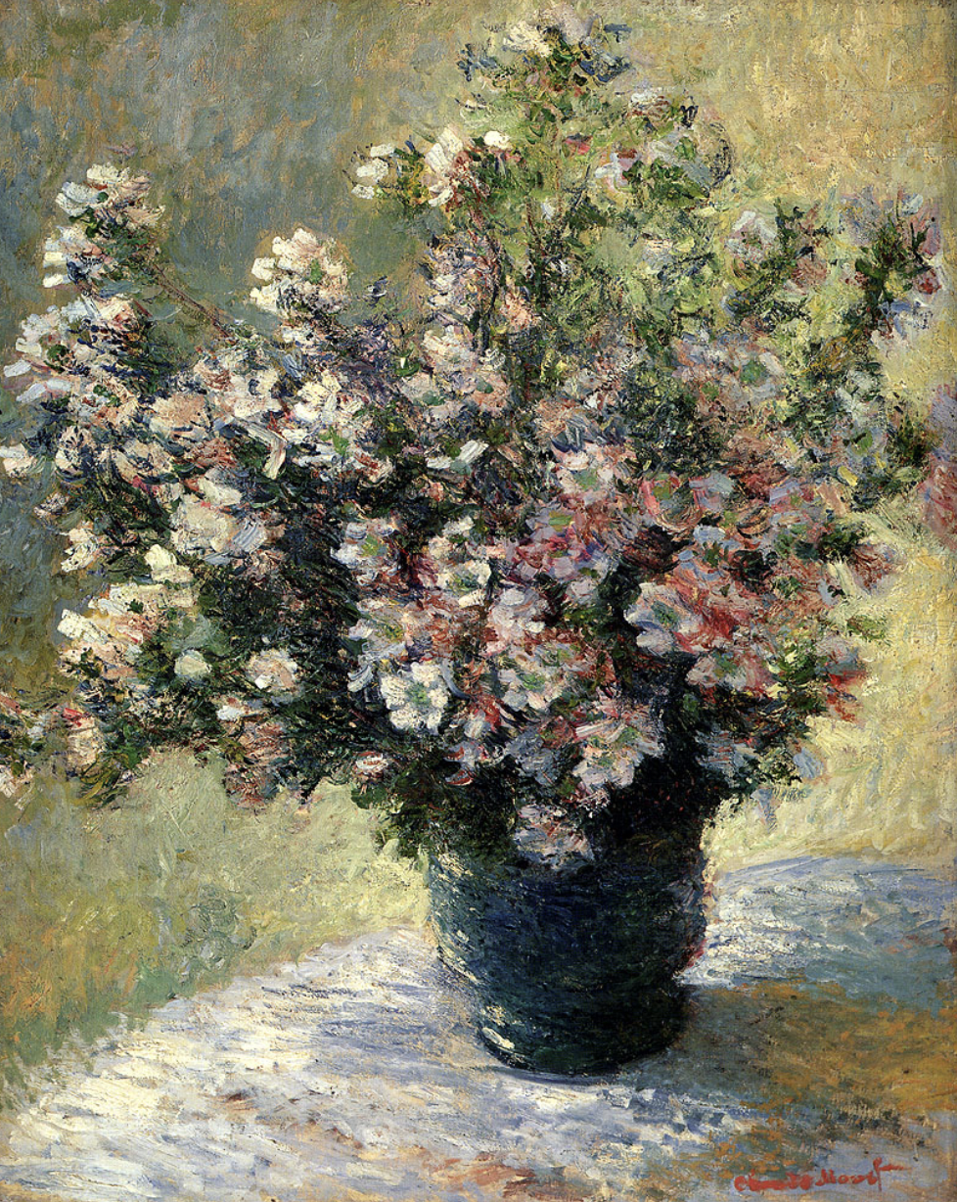
Now let’s try to apply it on different, more challenging dataset – flower paintings of Claude Monet

Slide 16
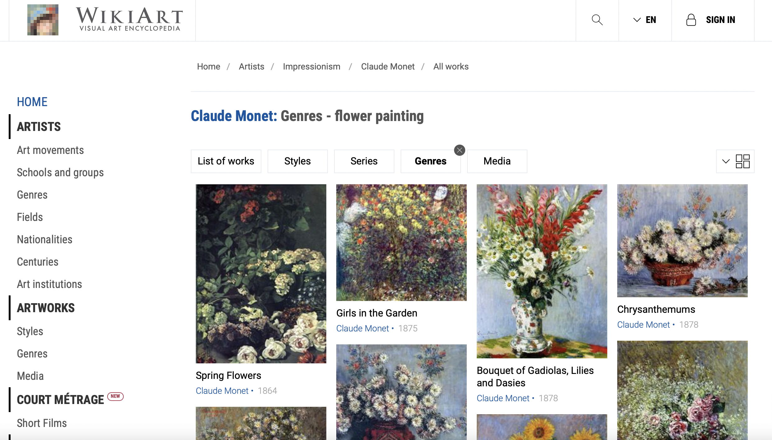
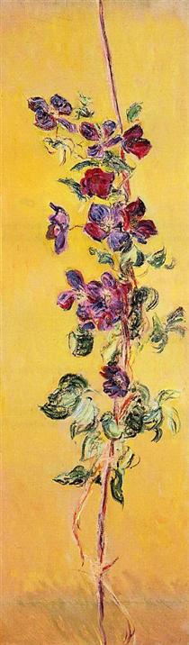
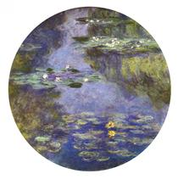
I was able to download 167 flower paintings of Claude Monet from WikiArt.org. I cleaned the data first by removing those with circular boundaries and very long canvasses (to avoid overstretching). We are left with 133 images.
Example of paintings removed

Slide 17
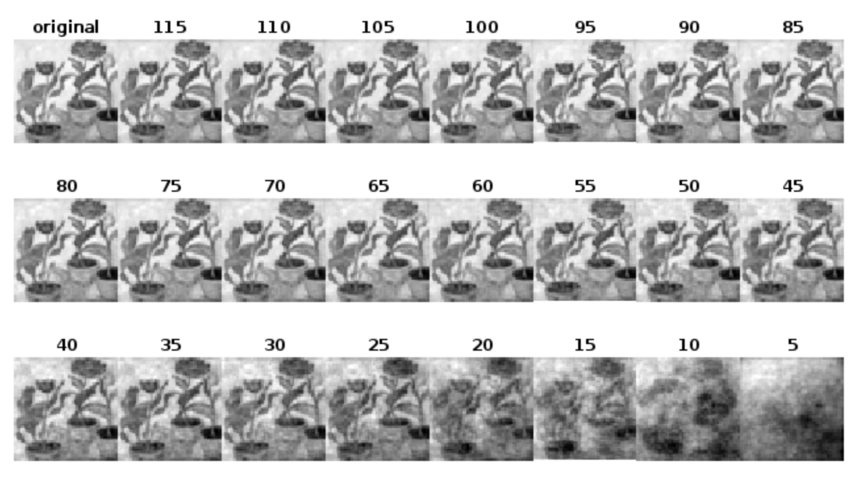
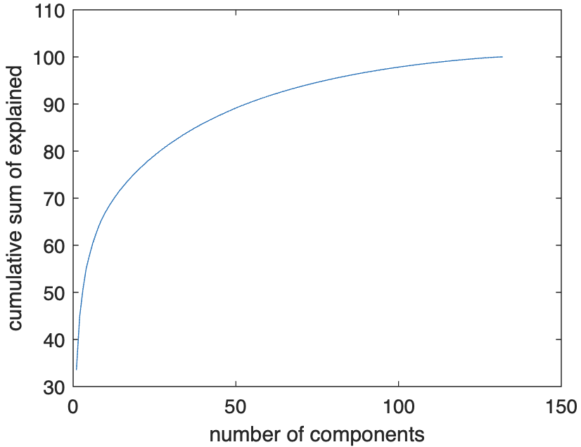
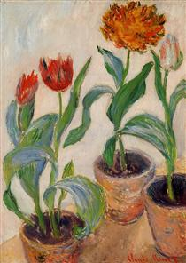
Sample of rendered flower painting for various principal components (PC=80 min for 95% contribution)
PC = 80, 95%
PC = 115, 99%
At around PC=25, we can already identify the flower painting. PC=25 has 78.5157% contribution.

Slide 18
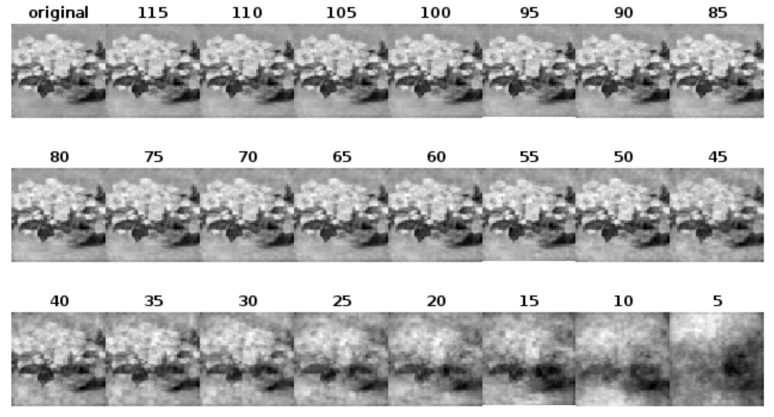
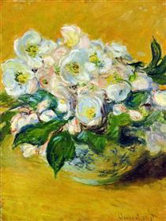
Another Sample of rendered flower painting for various principal components (PC=80 min for 95% contribution)
PC = 80, 95%
PC = 115, 99%
Here, it’s different. We can identify it at PC=80. For lower PCs, it looks like Brocolli.

Slide 19
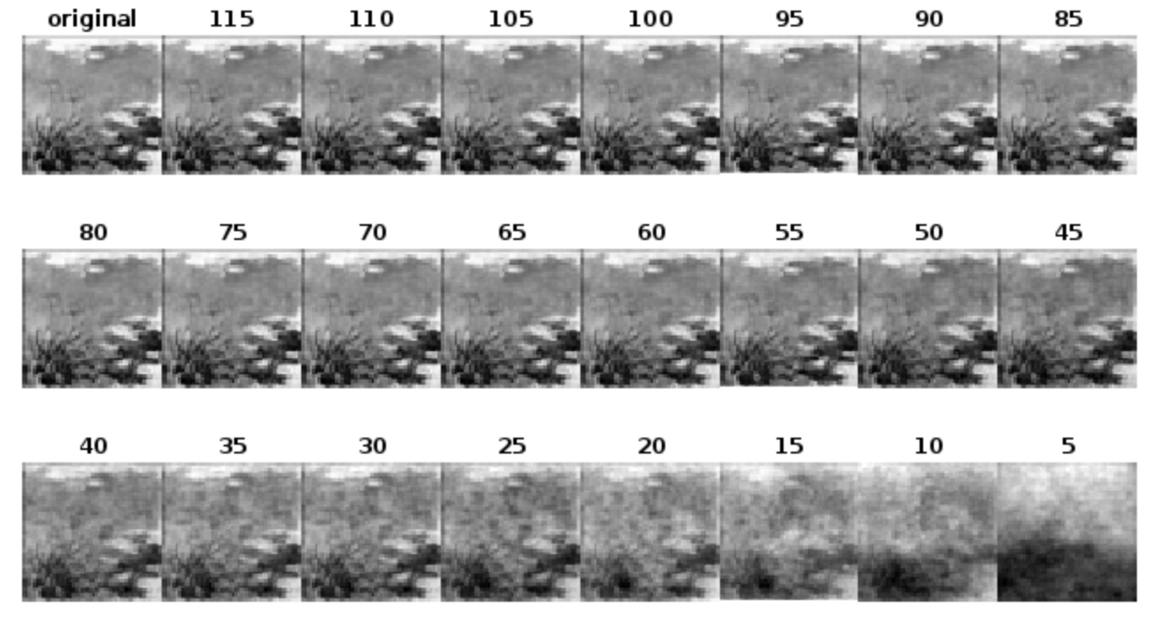
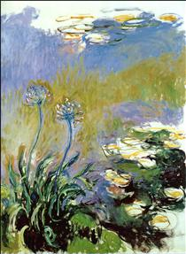
Another Sample of rendered flower painting for various principal components (PC=80 min for 95% contribution)
PC = 80, 95%
PC = 115, 99%
Here, we can identify it at PC=45.

Slide 20
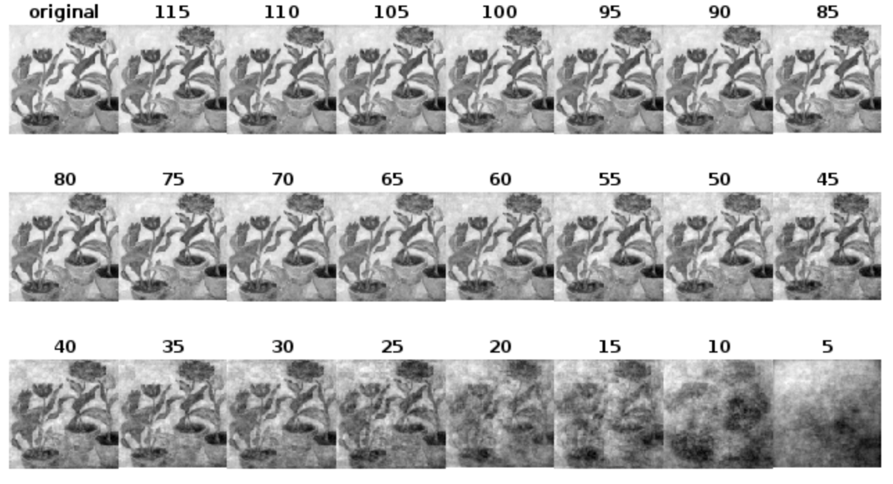
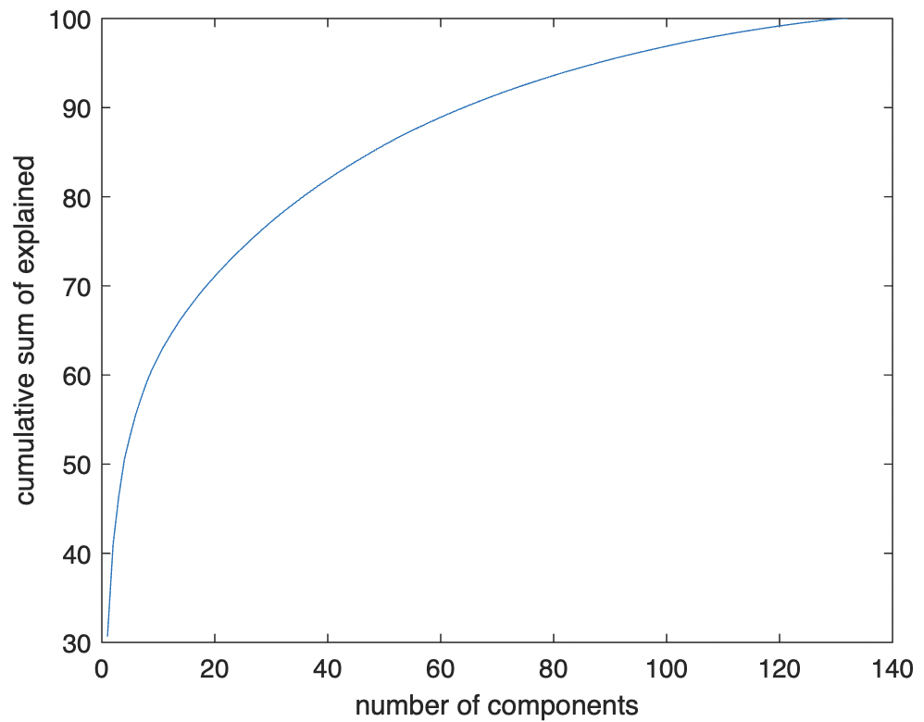
Sample of rendered flower painting for various principal components with size 100 by 100 (PC=90 min for 95% contribution)
I also tried adjusting the reshape size. Instead of 50 by 50, I made it 100 by 100.
PC = 80, 95%
50 by 50
PC = 115, 99%
PC = 90, 95%
PC = 120, 99%
100 by 100

Slide 21
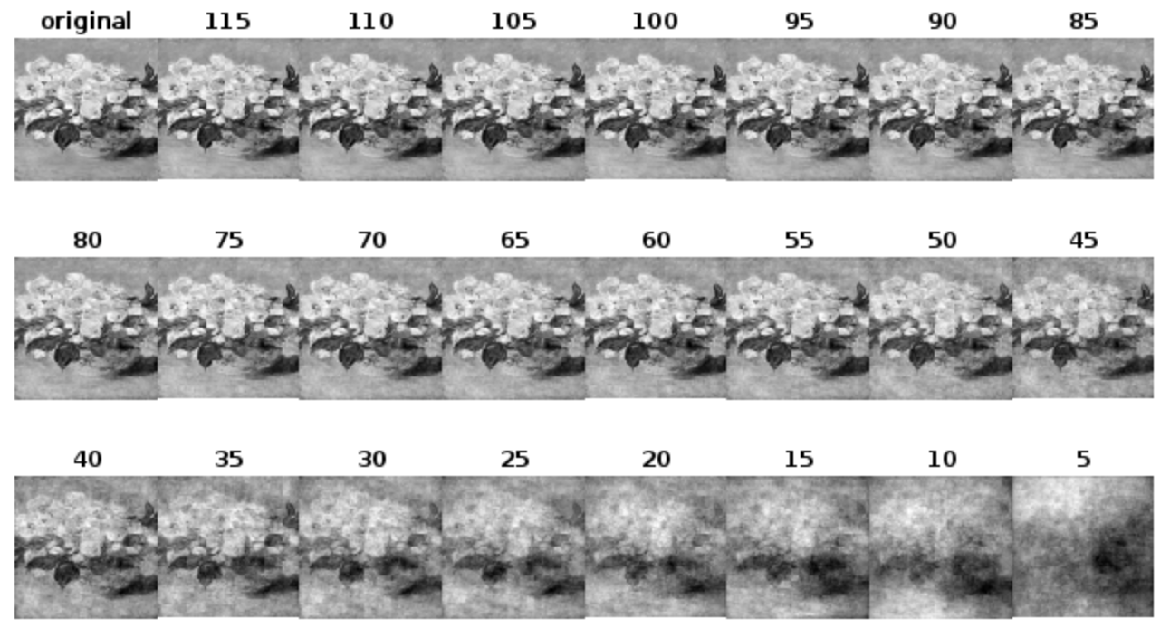
Sample of rendered flower painting for various principal components with size 100 by 100 (PC=90 min for 95% contribution)
As we can observes, higher size gives better results.
50 by 50
100 by 100

Slide 22

CRITERIA | QUALIFICATIONS | SCORE
Technical correctness | Met all objectives. Results are complete. Results are verifiably correct. Understood the lesson. | 30
Quality of presentation. | All text and images are of good quality. A picture or diagram of the setup is shown (if the activity has one). Code has sufficient comments and guides. All plots are properly labeled and are visually understandable. The report is clear. | 30
Reflection | Explained the validity of results. Discussed what went right or wrong in the activity. Justified the self score. Acknowledged sources (e.g. persons consulted, references, etc.) | 30
Ownership | Applied the technique on other data Discovered limitations in the technique (Not applicable, method is straightforward) Introduced improvements to the technique (Not applicable) | 10
100

